Slide 1
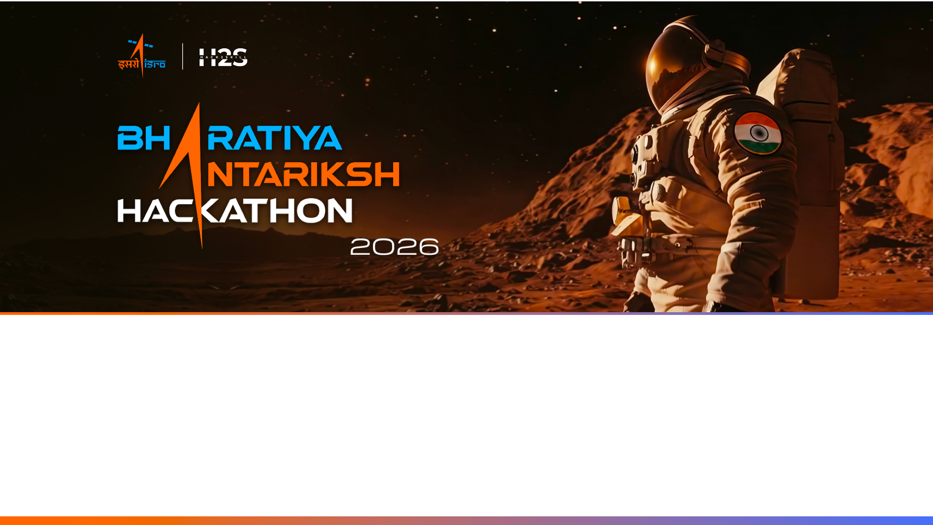
Team Name : Dinar
Team Leader Name : Mohammed Salman Fawaz
Problem Statement : Optimizing Urban Heat Mitigation and Cooling Strategies Via AI&ML

Slide 2

Team Members
Team Leader: Name: Mohammed Salman Fawaz College: Vaagdevi College Of Engineering | Team Member-1: Name: Abdul Raqib Nasif College: Vaagdevi College Of Engineering
Team Member-2: Name: Mohammed Bilad Rayan College: Vaagdevi College Of Engineering | Team Member-3: Name: Mohammad Nabeel Uz Zama College: Vaagdevi College Of Engineering

Slide 3
How different is it from any of the other existing ideas?
Current Urban Heat Island studies primarily focus on identifying hotspots or predicting Land Surface Temperature using statistical or machine learning techniques. While these approaches provide valuable observations, they rarely support decision-makers in selecting scientifically optimized mitigation strategies.
UrbanHeat Doctor AI extends beyond conventional heat mapping by introducing a complete Geospatial Decision Intelligence Framework.
The proposed platform integrates satellite remote sensing, physics-informed artificial intelligence, explainable machine learning, and optimization algorithms to not only identify heat hotspots but also diagnose their underlying causes, simulate multiple cooling interventions, and recommend the most effective solution based on environmental impact, implementation cost, and expected temperature reduction.
Unlike existing black-box AI models, the proposed framework embeds physical constraints governing urban energy balance, ensuring scientifically consistent predictions that remain interpretable and reliable across diverse urban environments.
The system therefore transforms satellite observations into actionable climate intelligence for sustainable urban planning.

Slide 4
List of features offered by the solution
Diurnal Radiometric Ingestion Module: Cross-calibrates daytime land surface temperatures with nighttime thermal emissions to monitor the active heat retention curves of concrete urban layouts.
Radiometric Driver Attribution Matrix: Uses Explainable AI (via SHAP feature weighting) to isolate and rank exactly what is causing a localized hotspot—calculating the precise percentage contribution of building mass, vegetation loss, or atmospheric moisture gaps.
Thermodynamic Loss Validation Core: A testing pipeline that monitors the AI's predictions against physical energy balance equations to eliminate data noise and ensure stable mathematical scaling across different cities.
Macro-Zonal Policy Sandbox: An interactive canvas where planners can adjust regional sliders (e.g., changing surface reflectivity from $0.2 \rightarrow 0.7$ or expanding tree canopies) to simulate city-wide microclimate responses.
Antariksh Automated Proposal Compiler: A formatting engine that instantly generates production-ready, coordinate-specific structural recommendations mapped to municipal zones.

Slide 5
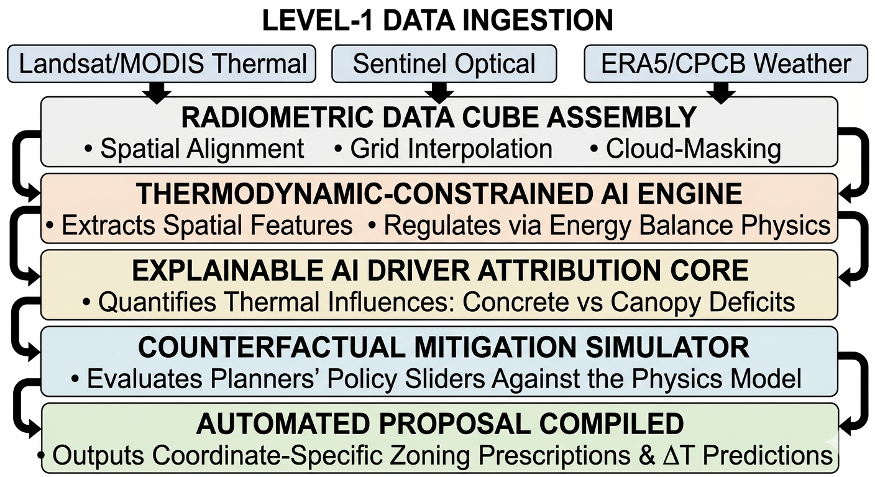
Process flow diagram or Use-case diagram
.

Slide 6
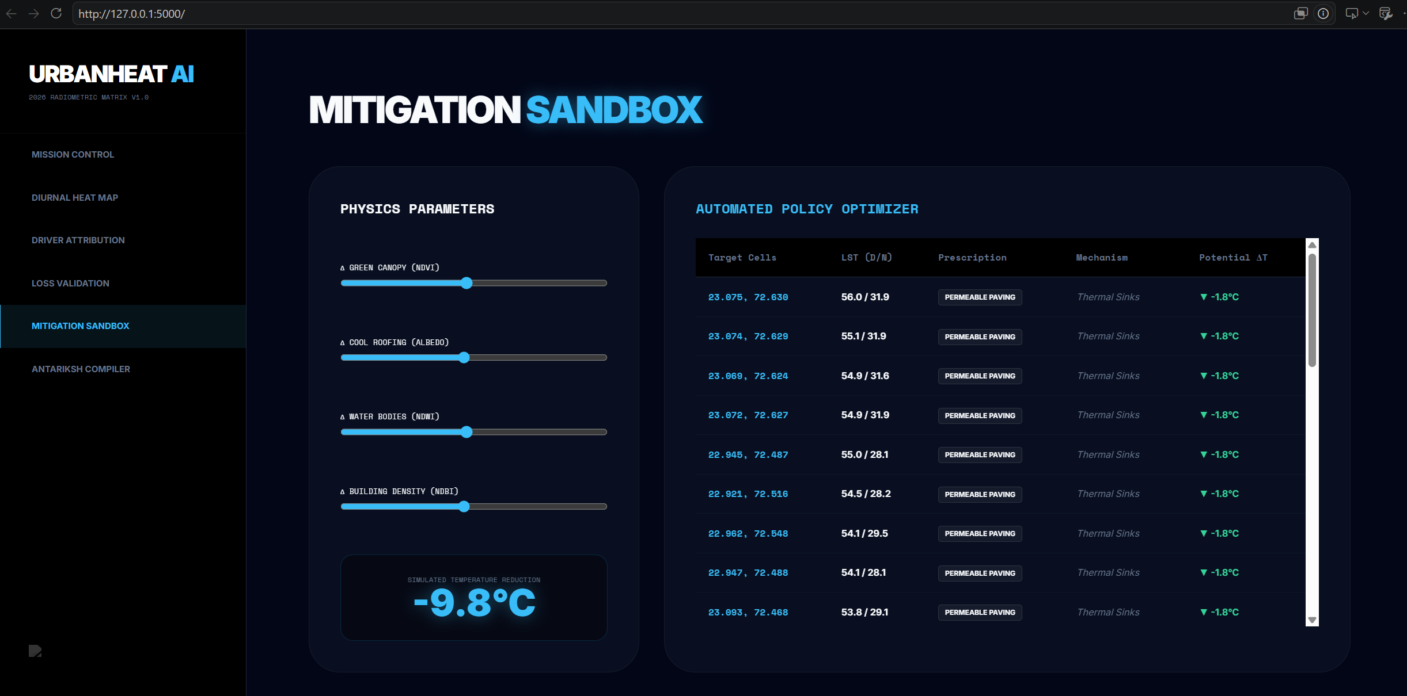
Wireframes/Mock diagrams of the proposed solution (optional)

Slide 7
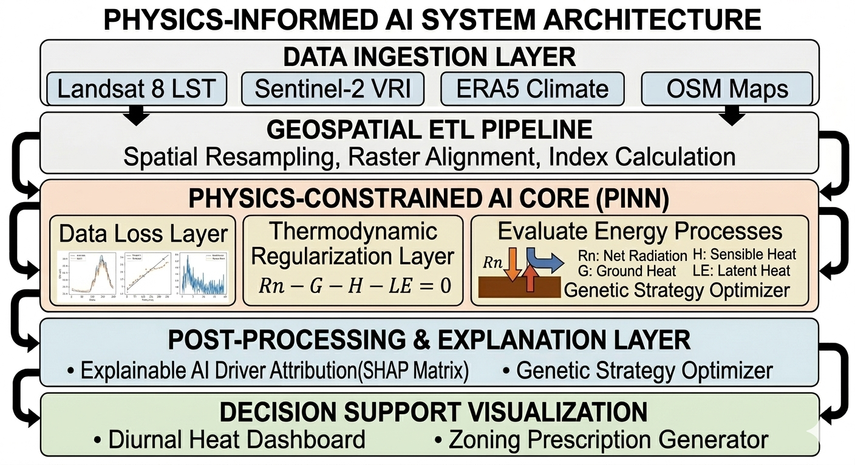
Architecture diagram of the proposed solution

Slide 8
Technologies to be used in the solution:
Geospatial Processing Ecosystem: Google Earth Engine (GEE) Python API & Planetary Computer for scalable processing of multi-temporal satellite records; Rasterio, GeoPandas, and Shapely for managing localized municipal vector layouts.
Physics-ML Modeling Core: DeepXDE (a specialized library for Physics-Informed Neural Networks) layered over a PyTorch/TensorFlow framework to handle customized thermodynamic loss tracking.
Explainable AI Integration: SHAP (SHapley Additive exPlanations) algorithm arrays for mathematical factor isolation and driver weighting calculations.
System Backbone & Infrastructure: Flask/Python environment for local server routing, integrated with structured JSON engines to cache multi-city analytical configurations.
Interface & Graphics Engine: Vite + React (Next.js) bundled with TailwindCSS for layout management, and Mapbox GL JS (or deck.gl) to handle high-performance geospatial data visualization overlays.

Slide 9
Estimated implementation cost (optional):
System Component | Resource Allocation Structure | Financial Footprint
Data Pipelines | Optimized data assembly via open-access cloud nodes (GEE/Planetary Computer Hubs). | ₹0 (Open Source)
Model Development | Model design using open framework architectures (DeepXDE / PyTorch / SHAP). | ₹0 (Academic Free-Tier)
System Interface | System layout built using web components (Next.js / Mapbox GL JS). | ₹0 (Developer License)
Deployment Footprint | Designed for straightforward local setup or standard municipal server node hosting. | Minimal Operational Cost

Slide 10


